Slide 1
Decision Trees

Slide 2
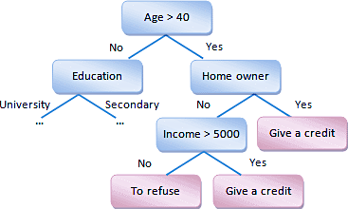
About Decision TREE
A Decision Tree is one of the best approaches to be used mostly in supervised learning algorithms.
Empowers predictive models with higher accuracy and interpreting is quite easy
Type: Supervised Learning Algorithm (having a predefined target variable)
Works Both for Categorical & Continuous Variables.
In this Technique, the Data is divided on basis of highly significant input variable.
Lets say a credit offering company wants to decide on offering credit to 100 customers. The company can decide on basis of following parameters:
Income, Married, Educated, Past Credit History, Credit Score
Houseowner, Credit Card Owner and so on.
In his problem, we need to segregate customers basis above input paramters. This is where Decision Tree comes handy.

Slide 3
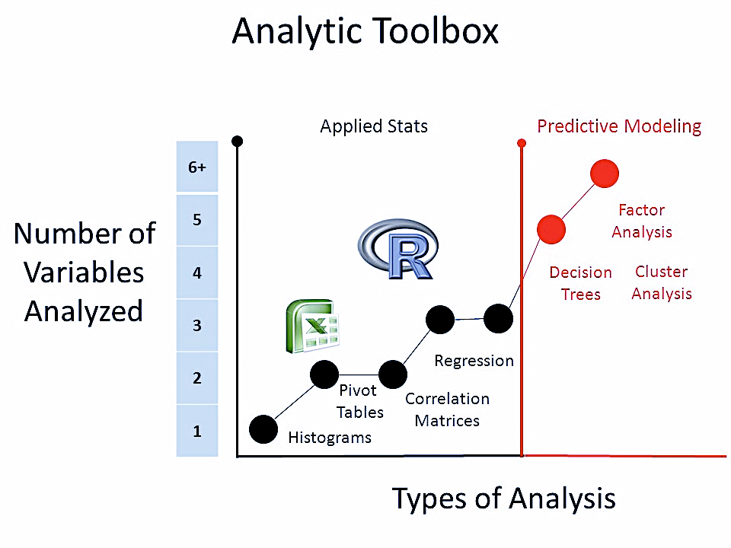
Decision Tree Types
Types of Decision Trees:
Categorical Variable Decision Tree: A Tree that has categorical Target Variable. For e.g. Offer Loan to Customer – yes/no
Continuous Variable Decision Tree: A Decision Tree that has continuous Target Variable
For e.g. Insurance company wants to find out whether the customer will pay policy premium(yes/no).
Here we know that customer is highly significant input variable and can be used in root node.
Hence, we will use other variables such as income, policy type, occupation to predict the value of continuous variable.

Slide 4
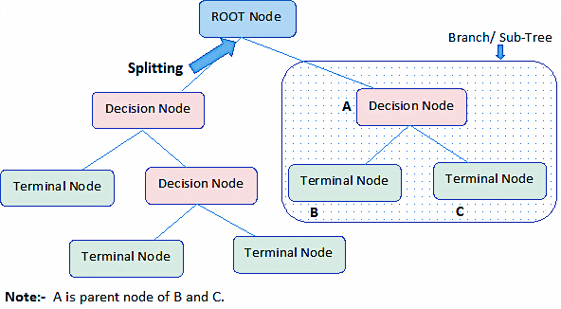
Decision tree structure
Root Node: It represents entire population or sample and
it is further divided in homogenous set
Splitting: Process of Dividing a node in sub-nodes
Branch/Sub-Tree: A subsection of Entire Tree
Decision Node: When a sub-node is divided in further sub-nodes, then It is called Decision Node.
Parent/Child Node: A Node that is divided in sub node is called Parent Node and sub-nodes are called Child of Parent Node.
Terminal Node: Nodes that do not split further are called Leaf or Terminal Node.
Pruning: Removing a sub-node from a Decision Node results in Pruning

Slide 5
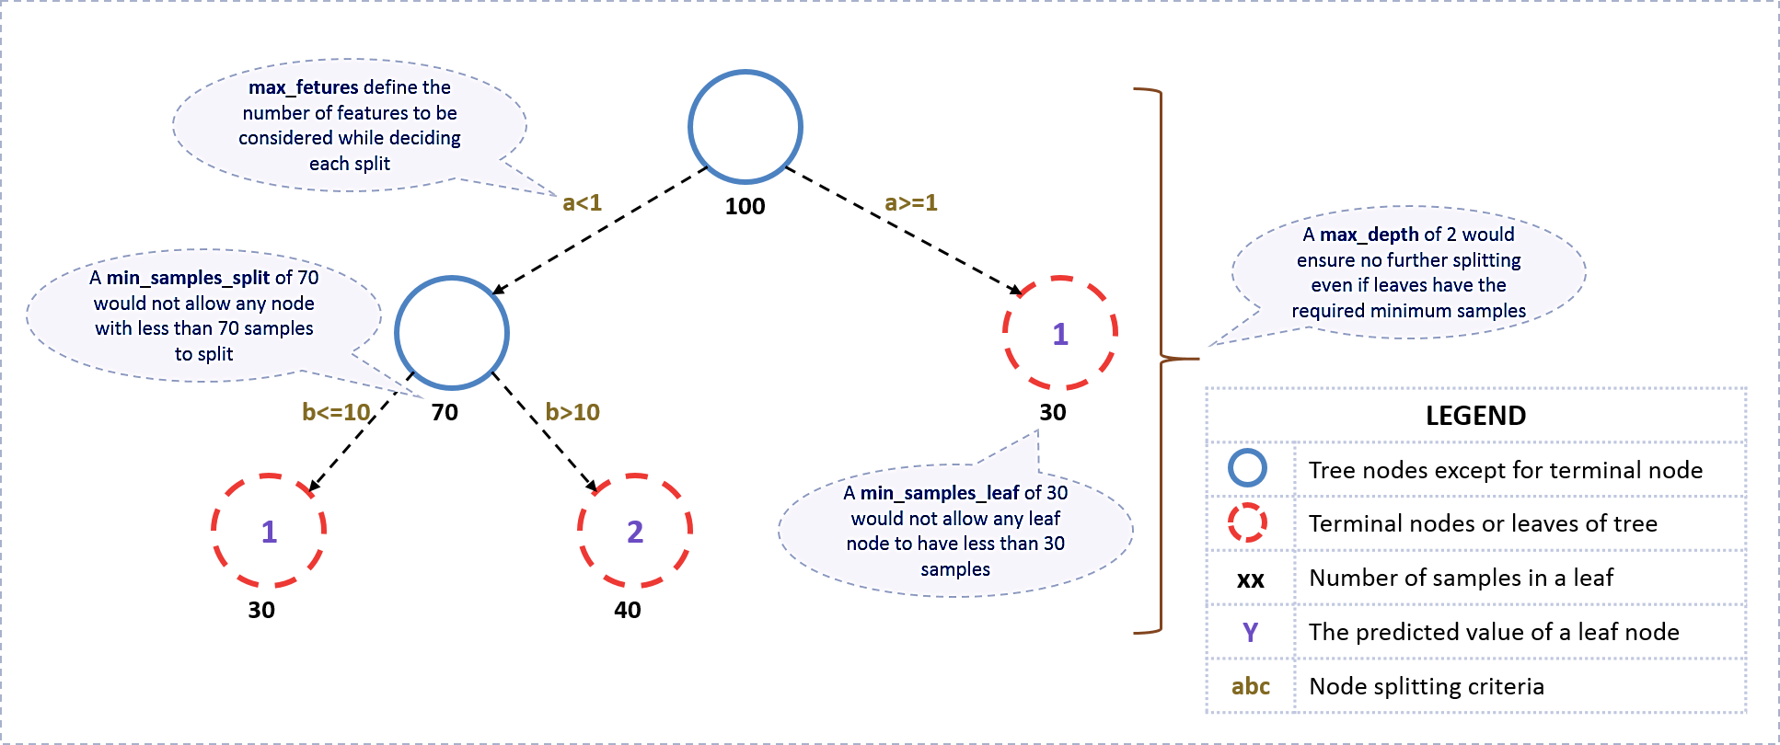
Decision Tree Structure

Slide 6
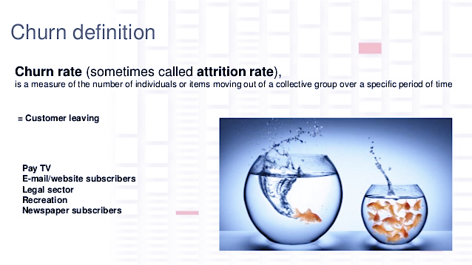
Industry Usage
Credit Scoring
Churn Prediction
Direct Marketing
Medical Sciences
Recommender Systems
Credit Card Fraud Detection

Slide 7
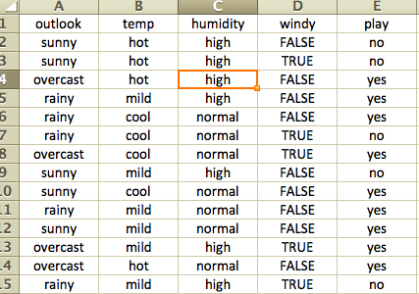
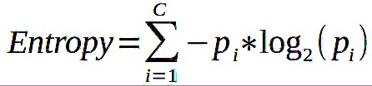
Maths behind Decision Tree - Entropy
There are two algorithm for the construction of Decision Tree – Gini Index & ID 3 (Iterative Dichotomiser -3)
Here will focus on ID3. It used Entropy and Information Gain as Metrics. So now we are going to find out the Root Node basis ID3 Algorithm.
Entropy – It is the measure of uncertainty/impurity in the data.
B B B
R R
H – Entropy
i – Set of classes in Data set
p(i) - proportion of no of elements of i in Dataset (S)
S – current dataset. For e.g. Basketball Data
B B B
R R
Remember that for a Binary Classification Problem if all examples are +ve or all are –ve then entropy will be 0 i.e. low. If half of the examples are +ve and half are –ve then entropy is One i.e. high.

Slide 8
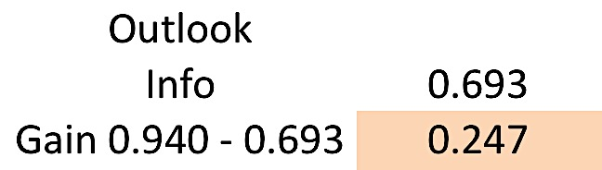
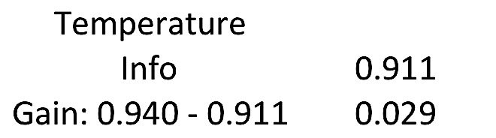
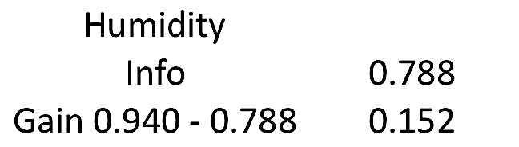
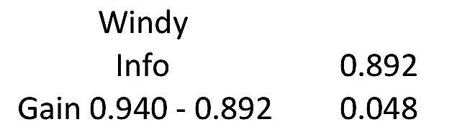
Entropy calculation: basketball data
Step1: Find the Entropy of the target
C(Outlook=overcast) = 04 Yes and 0 No
E(Outlook=overcast) = [-(4/4)*log2(4/4) – (0/4)*log2(0/4)] = 0
C(Outlook=rainy) = 03 Yes & 02 No
E(Outlook=rainy) = [-(3/5)*log2(3/5) – (2/5)*log2(2/5)] = 0.971
C = {yes,no}
Total Observations – 14. 09 are classified as Yes and 5 as No
pyes = -(9/14) * log2(9/14) = 0.41
pno = -(5/14) * log2(5/14) = 0.53
E(S) = pyes +pno = 0.94
Step 3: Find the Average Entropy for Outlook
Inf(outlook) = 5/14*(0.971) +4/14*(0) + 5/14 * 0.971 = 0.693
Step4: Calculate the Information Gain of Outlook
Gain(Outlook) = E(S) – Inf(outlook) = 0.247
Step2: Calc. Entropy & Information Gain for Every Feature.
Similarly, we will find out the Entropy& Inf. Gain of All the Variables. We will pick the highest gain attribute
C(Outlook=Sunny) = 02 Yes and 03 No
E(Outlook=Sunny) = [-(2/5)*log2(2/5) – (3/5)*log2(3/5)] = 0.971

Slide 9
Introduction to Decision Tree
Decision Tree is used for regression and classification, more often classification.
Can be used for binary classification such as whether an applicant for loan is likely to turn into defaulter or not.
Decision tree algorithm finds the relation between the target column and the independent variables and express it as a tree structure.
It does so by binary splitting data using functions based on comparison operators on the independent columns.

Slide 10
Common measures of Impurity
Entropy
A measure of uncertainty.
Given that there are two possible outcomes for a given action.
We can express the relation between probability and impurity of target column in a mathematical form.

Slide 11
Gini Index
Is calculated by subtracting the sum of the squared probabilities of each class from one.
Perfectly classified, Gini Index would be zero
Uses squared proportion of classes.

Slide 12
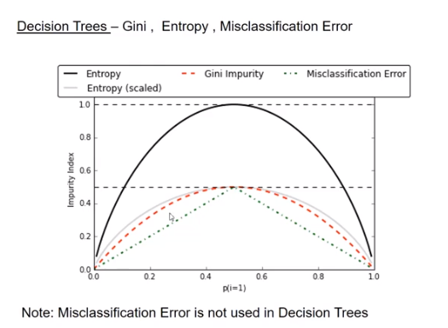

Slide 13
Interview Questions
A decision tree can be used to build models for
Classification Problems
Regression Problems
Both the Above

Slide 14
Interview Questions
A decision tree can be used to build models for
Classification Problems
Regression Problems
Both the Above

Slide 15
Interview Questions
A Decision Tree is built in ________ fashion
Top-down
Bottom-up
Both the Above

Slide 16
Interview Questions
A Decision Tree is built in ________ fashion
Top-down
Bottom-up
Both the Above

Slide 17
Interview Questions
The goal of feature selection while building a decision tree is to
Find features or attributes which lead to split in children nodes which has _________ entropy.
Maximum
Minimum
None of the Above

Slide 18
Interview Questions
The goal of feature selection while building a decision tree is to
Find features or attributes which lead to split in children nodes which has _________ entropy.
Maximum
Minimum
None of the Above

Slide 19
Interview Questions
A data segment in decision tree is said to be pure if all the data instances belong to the
Single Class
Multiple Class
No Idea

Slide 20
Interview Questions
A data segment in decision tree is said to be pure if all the data instances belong to the
Single Class
Multiple Class
No Idea

Slide 21
Interview Questions
The goal of feature selection while building a decision tree is to
find features which result in ________ information gain.
Maximum
Minimum
None of the Above

Slide 22
Interview Questions
The goal of feature selection while building a decision tree is to
find features which result in ________ information gain.
Maximum
Minimum
None of the Above

Slide 23
Interview Questions
Entropy value of _____ represents that data sample is pure and homogenous.
1
0
None of the Above

Slide 24
Interview Questions
Entropy value of _____ represents that data sample is pure and homogenous.
1
0
None of the Above

Slide 25
Interview Questions
Entropy value of _____ represents that data sample is pure and homogenous.
1
0
None of the Above

Slide 26
Advantages and Disadvantages
Advantages
Simple to understand and Interpret
Able to handle both numerical and categorical data
Requires little preparation
Uses white box model
Performs well with large datasets
Mirrors human decision making nicely.
Disadvantages
Trees can be non robust. A small change in training data results large change in tree
Can create over complex trees which tend to overfit.
For data including categorical variables with different no of levels, information gain in trees is biased in favor of attributes with more levels.
Sensitive to Noisy Data. It can easily overfit noisy data.

Slide 27
Hands on exercise on Decision Tree
he dataset used here is Credit data (https://archive.ics.uci.edu/ml/datasets/statlog+(german+credit+data))
Some important functions
Importing libraries
import numpy as np
import pandas as pd
from sklearn.tree import DecisionTreeClassifier
for feature in credit_df.columns : # loop through all columns in the dataframe
if credit_df[feature].dtype == ‘object’ : # only apply for columns with categorical variables
credit_df[feature] =pd.categorical(credit_df[feature]).codes

Slide 28
Splitting data into training and test sets for independent attributes
train_set = credit_df.head(500)
test_set = credit_df.tail(500)
capture the target column (“default”) into separate vectors for training set and test set
train_labels = train_set.pop(“default”)
test_labels = test_set.pop(“default”)
Invoking the decision tree classifier function
dt_model = DecisionTreeClassifier (criterion = ‘entropy’, random_state=1)
dt_model.fit(train_set, train_labels)

Slide 29
DecisionTreeClassifier (class_weight=None, criterion = ‘entropy’, max_depth=None, max_features=None, etc…)
dt_model.score(test_set, test_labels)
dt_model.score(train_set, train_labels)

Slide 30
Case Study - Wine quality production
Context
The dataset is related to red variants of the Portuguese “Vinho Verde” wine. Due to privacy and logistic issues, only physicochemical (inputs) and sensory (output) variables are available ( eg: there is no data about grape types, wine brand, wine selling price, etc.)
These datasets can be viewed as classification or regression tasks. The classes are ordered and not balanced (eg, there are much more normal wines than excellent or poor ones).

Slide 31
Dataset
https://www.kaggle.com/uciml/red-wine-quality-cortez-et-al-2009
Problem Statement
Wine Quality Prediction - Here, we will apply a method of assessing wine quality using a Decision Tree, and test it against the wine-quality dataset from the UC Irvine machine learning repository. The wine dataset is a classic and very easy multi-class classification dataset.

Slide 32
Data Attributes
Fixed Acidity 10. Sulphates
Volatile acidity 11. Alcohol
Citric acid 12. Quality
Residual sugar
Chlorides
Free sulphur dioxide
Total sulphur dioxide
Density
pH

Slide 33
Steps to follow
Import all necessary libraries and load the data
Print the descriptive statistics of each & every column using describe() function
Using univariate analysis check the individual attributes for their basic statistic such as central values, spread, tails etc.
Use pairplots and correlation method to observe the relationship between different variables and state your insights.
Split the wine_df into training and test set in the ratio of 70:30 (Training:Test) based on dependent and independent variables.
Create the decision tree model using “entropy” method of finding the split columns and fit it to training data.

Slide 34
7. Print the accuracy of the model & print the confusion matrix
8. Regularize the decision tree by limiting the max. depth of trees and print the accuracy.

Slide 35


Questions?

